Slide 1

Company Management System (MVC)
A comprehensive web-based system to streamline managing employees, departments, projects, users, and services for HR and managers.
Team Members:
Mohamed Yasser Mohamed Selem
Mostafa Elmahdy Atwa
Mostafa Yasser Abd El Hameed Eid
Mohamed Hassan Elanwar Mohamed Elkhodary Mohamed
Mahmoud Ahmed Mahmoud Amin
Supervisor Name: AST

Slide 2

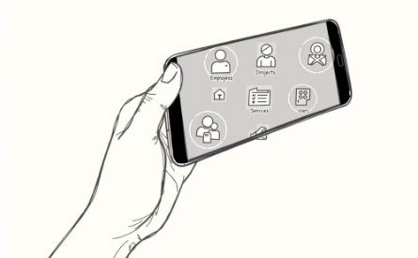

​Sy​stem Overview
3-Tier Architecture
Key Features
Technology Stack
Data Access, Business Logic, and Presentation Layers are separated to promote modularity and maintainability.
Employee Management
Built with ASP.NET Core MVC for robust web development, SQL Server for efficient data storage, and Entity Framework Core for simplified data access.
Department Management
Project Management
Users Management
Services Management
Role Management
Login
Register
Forget Password

Slide 3
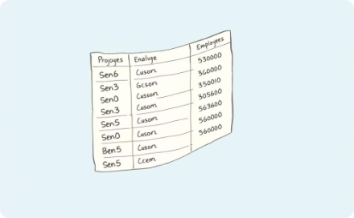

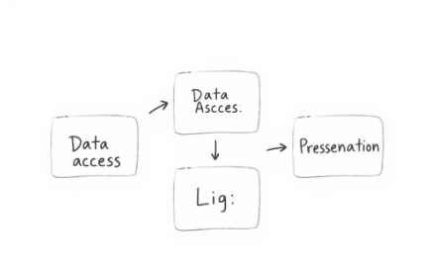
Data Access Layer
Database Models
Data Access Components
Separation of Concerns
Represent entities like employees, departments, projects, users, and services.
Interact with the database using DbContext for migrations and CRUD operations.
Isolates data access logic from business rules and presentation.

Slide 4

Business Logic Layer
1
Interfaces
2
Repositories
3
Unit of Work

Slide 5
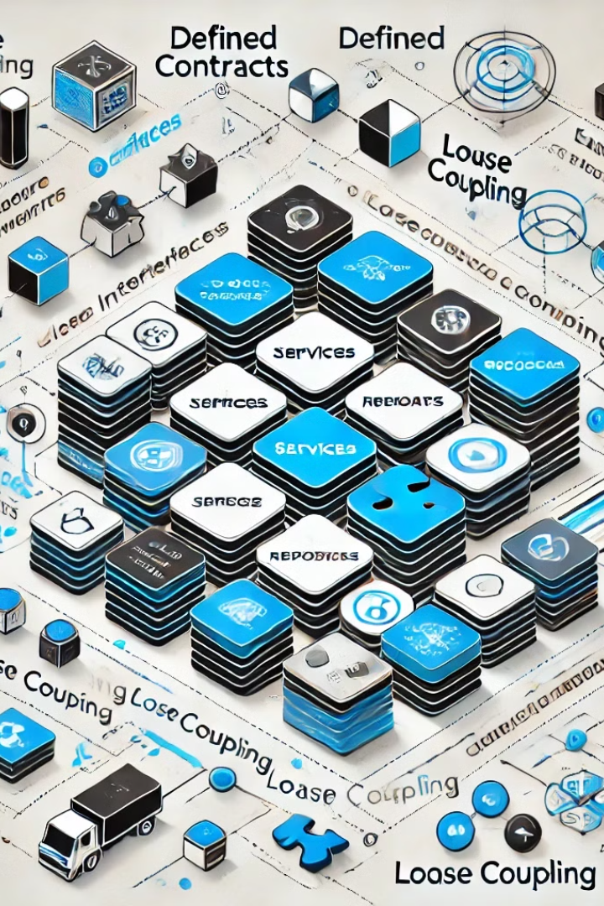
Interfaces
Define contracts for services and repositories, promoting loose coupling and easier testing.

Slide 6
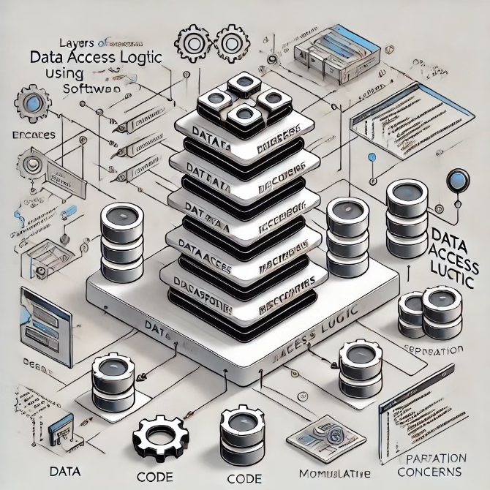
Repositories
Abstract data access logic, providing methods for querying and manipulating data entities. This allows for cleaner code and separation of concerns.

Slide 7

Unit of Work
A design pattern that coordinates the work of multiple repositories, ensuring that changes to the database are managed as a single transaction.

Slide 8
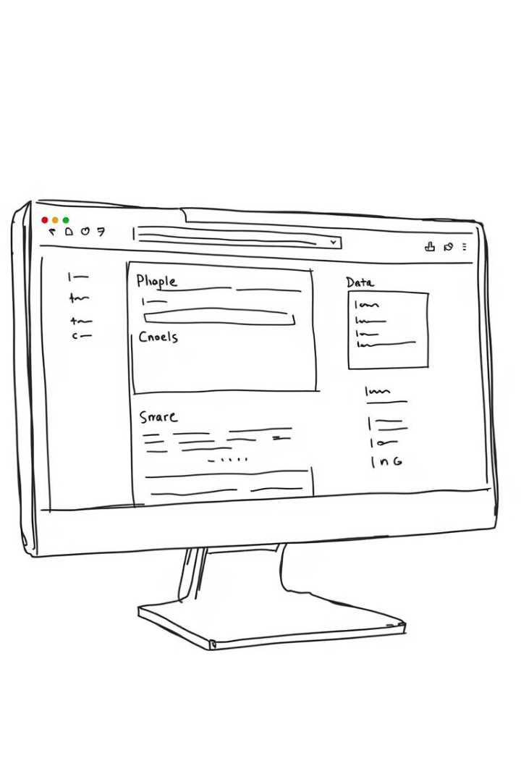
Presentation Layer
1
Controllers
Responsible for handling user requests, converting them to data models, and selecting the appropriate view.
2
View Models
Transform data from the data layer for presentation purposes, making it easy to display in the user interface.
3
Views
The visual representation of the user interface, where users interact with the system.
Controllers
View Models
Views
Handle requests, map to models and views, and implement business logic.
Bridge between UI and data models, tailoring data for presentation.
Represent the user interface, including forms, lists, and dashboards.

Slide 9

Controllers
Handle requests, map to models and views, and implement business logic.

Slide 10
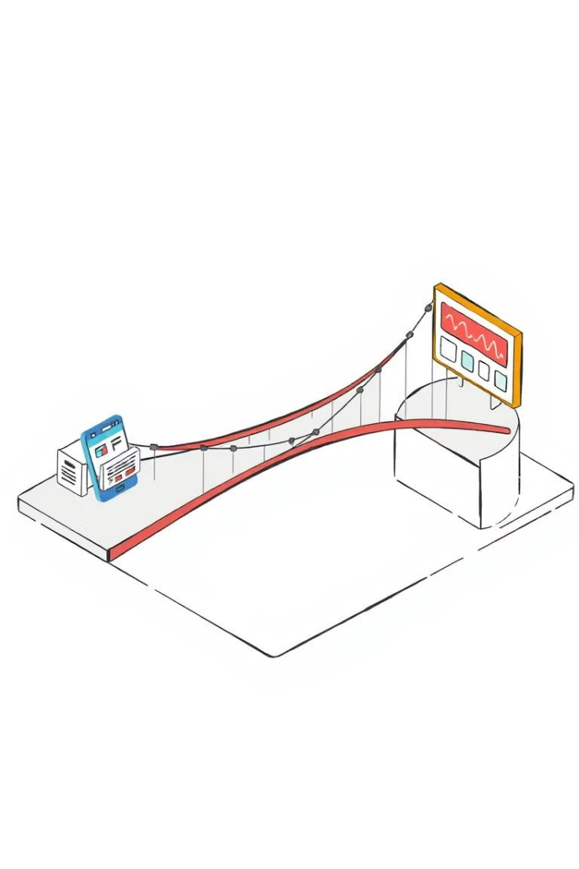
View Models
Bridge between UI and data models, tailoring data for presentation.

Slide 11
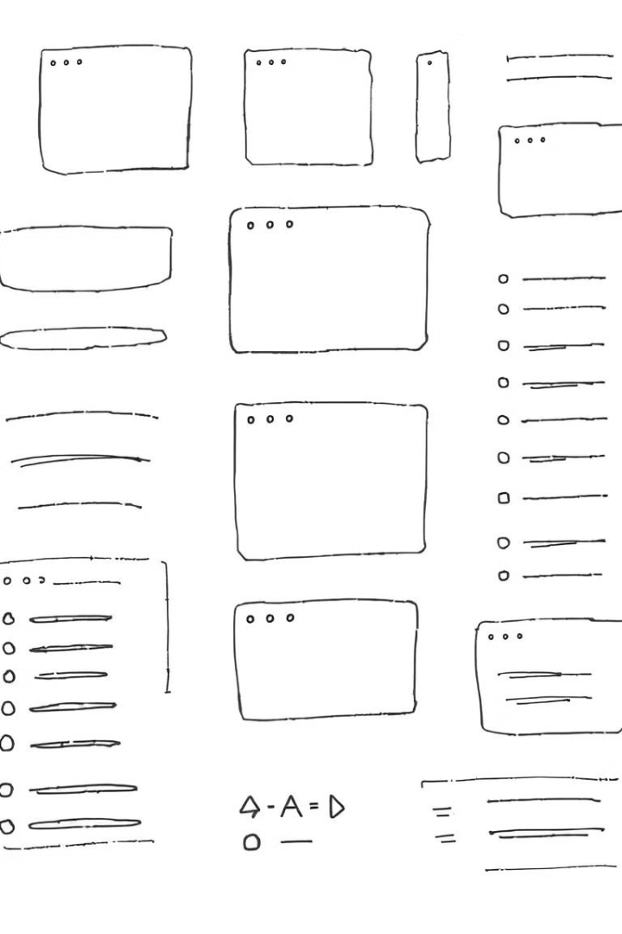
Views
Views are the visual representation of the user interface, responsible for displaying data, user input elements, and interactive components. They leverage HTML, CSS, and JavaScript to create the front-end experience that users interact with. For example, a view might display a list of employees, a form for editing a user profile, or a dashboard showcasing key performance indicators. The presentation layer relies on views to translate data from the view models into the user interface, ensuring a seamless and intuitive user experience.

Slide 12
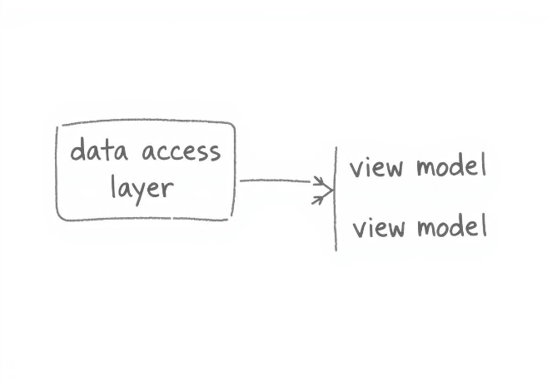

Mapping Profiles
Mapping Configuration
AutoMapper
Defines how data access layer entities are mapped to view models, ensuring data consistency and simplifying data transformations for presentation.
Automates mapping between different data models, minimizing the need for manual mapping code and reducing the risk of errors.

Slide 13
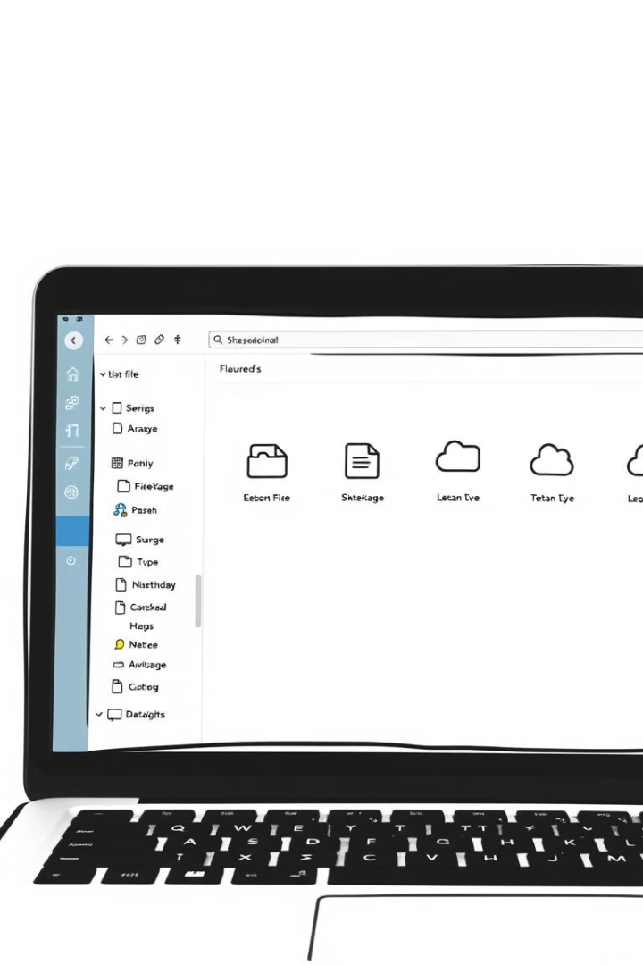


Document Management
Upload
Save files securely with unique file names.
Delete
Remove files from the system if needed.

Slide 14
Email Settings
SMTP Server
Authentication
Email Behavior
Configure the SMTP server details, including hostname, port, and encryption settings.
Define authentication credentials, such as username and password, for sending emails.
Set options to customize email sending behavior, like specifying the sender address or enabling email logging.

Slide 15
contributors
Mohamed Yasser Mohamed Selem => Controllers, ViewModel
Mostafa Elmahdy Atwa => Data Access Layer (Contexts, Migrations, Models)
Mostafa Yasser Abd El Hameed Eid => Mapping Profiles, Document Management , Email Settings
Mohamed Hassan Elanwar Mohamed Elkhodary Mohamed => Business Logic Layer (Interfaces , Repositories , Unit of Work)
Mahmoud Ahmed Mahmoud Amin => Presentation Layer (Views)

Slide 16

Supervisor
AST
The project supervisor guiding the team's development efforts.

